Slide 1

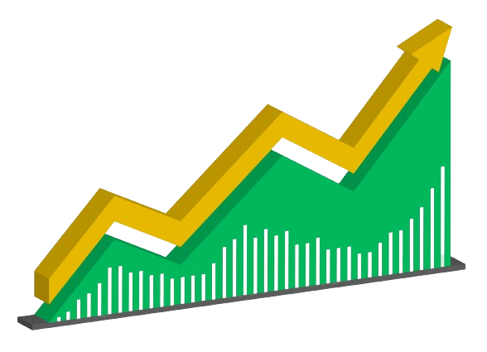


Stock market prediction using Machine learning
Mausam Gurung ( supervised by Sujan Shrestha)
Kathmandu Engineering college (Kalimati, Kathmandu)
OKRP Conference 2023

Slide 2



Stock market
Fundamental
Analysis
Technical
Analysis
Assess a company's financial health, industry trends, and economic climate.
Analyze historical price and volume data to identify patterns and predict future movements.
Machine Learning:
Advanced algorithms are being explored to predict market trends with greater accuracy.
OKRP Conference 2023

Slide 3
Traditional programming vs machine learning
Machine learning:
Machine learning is a subfield of artificial intelligence that uses algorithms trained on data sets to create models that enable machines to perform tasks that would otherwise only be possible for humans, such as categorizing images, analyzing data, or predicting price fluctuations.
Rules
Traditional programming
Answer
Data
Answer
Machine learning
Rules
Data
OKRP Conference 2023

Slide 4
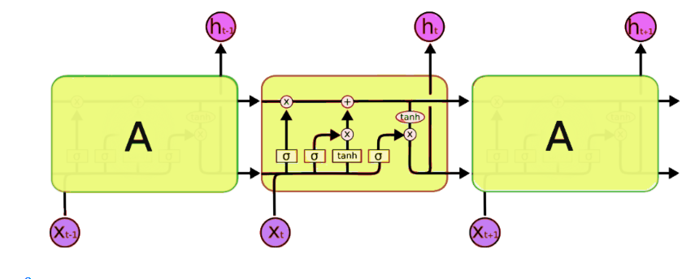
Model I: LSTM [Long Short Term Memory]
Recurrent Neural Network (RNN)
Based on cell states and hidden states
LSTMs work by processing sequential data allowing the network to selectively remember or forget information as it processes the data, enabling it to handle long-term dependencies and complex patterns in the data
OKRP Conference 2023

Slide 5
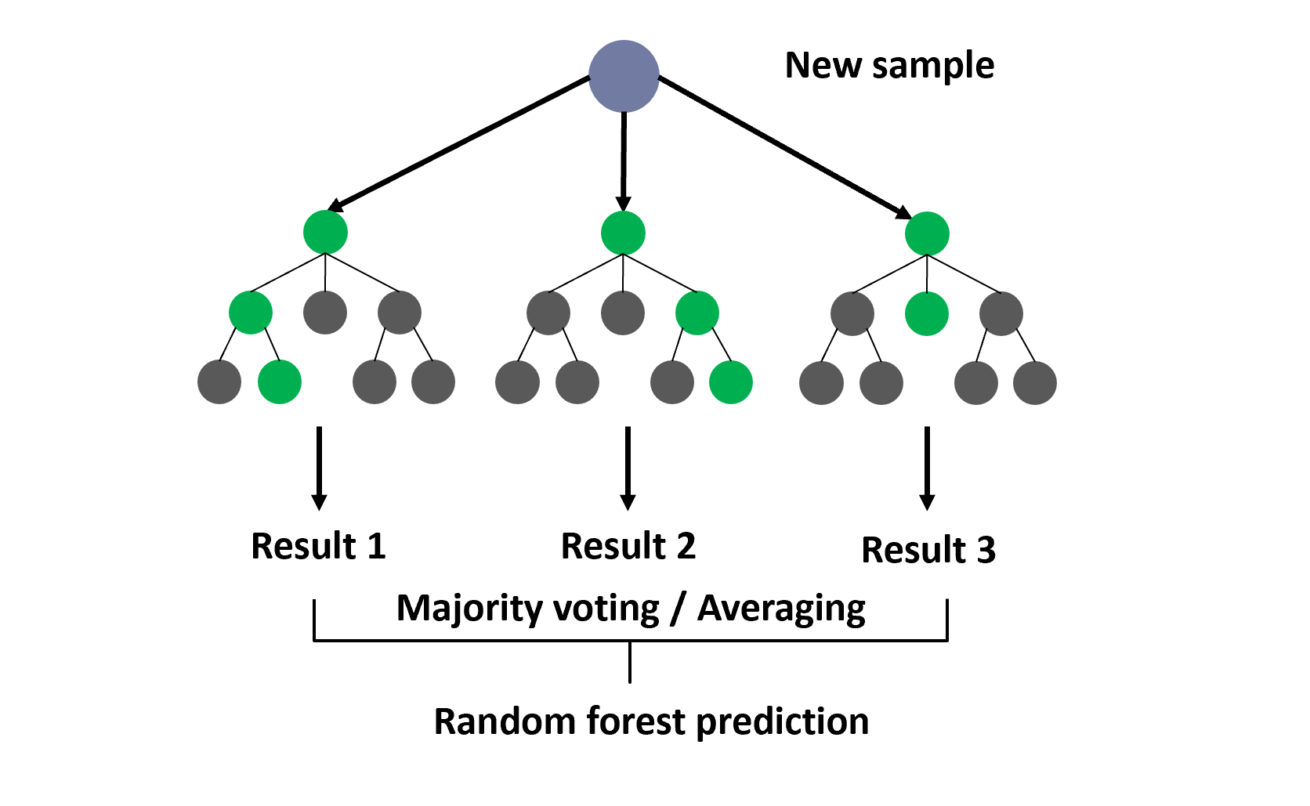
Model II: Random Forest
Multiple decision trees are trained on random subsets of the training data, and each tree is built with a different set of features. The final prediction is made by aggregating the predictions of all the trees
Its ability to handle high-dimensional data and to provide accurate predictions even with a small number of training examples make it a popular choice for many machines learning tasks.
OKRP Conference 2023

Slide 6
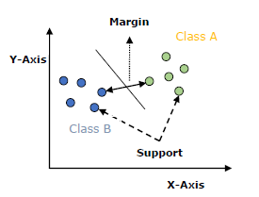
Model III: SVM[Support Vector Machine]
supervised learning algorithm that can be used for classification and regression tasks.
SVMs work by transforming the data into a higher-dimensional space using a kernel function, and then finding the optimal hyperplane that maximizes the margin between the classes using a quadratic programming algorithm.
OKRP Conference 2023

Slide 7
Datasets and Parameters and library used
Dataset taking from the commercial bank.
The dataset I take is form NABIL Bank
Source [shareshansar.com and nepsealpha.com]
And the ten technical parameters:
Simple Moving Average
Relative Strength Index (RSI)
Weighted Moving Average
Moving Average Convergence Divergence (MACD)
Momentum
Larry William R%
Stochastic %K
A/D (Accumulation/Distribution) Oscillator
Stochastic %D
Commodity Channel Index
OKRP Conference 2023

Slide 8
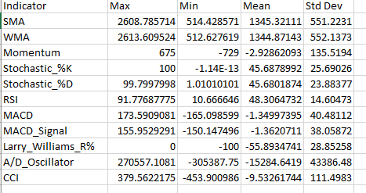
Library like Talib, matplot, panda , numpy, sklearn, tensorflow, keras
NABIL Bank Technical indicator
OKRP Conference 2023

Slide 9
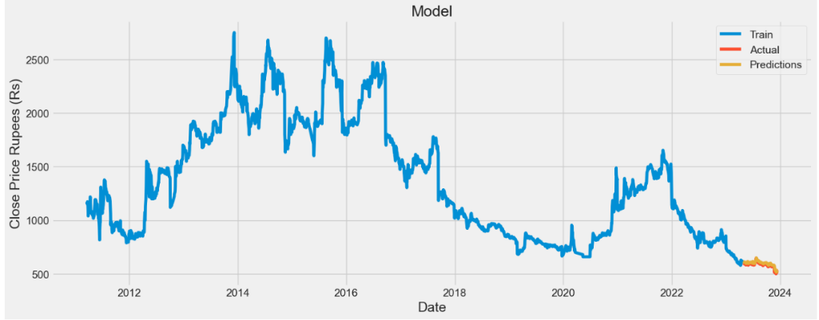

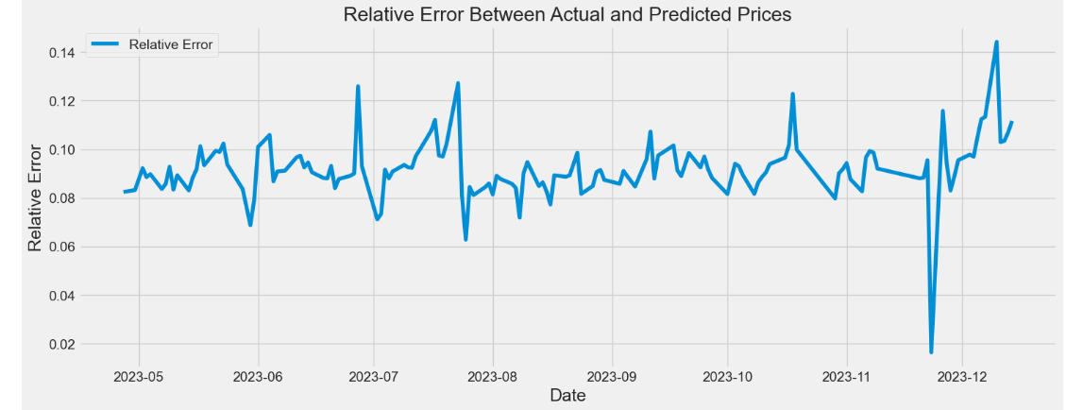
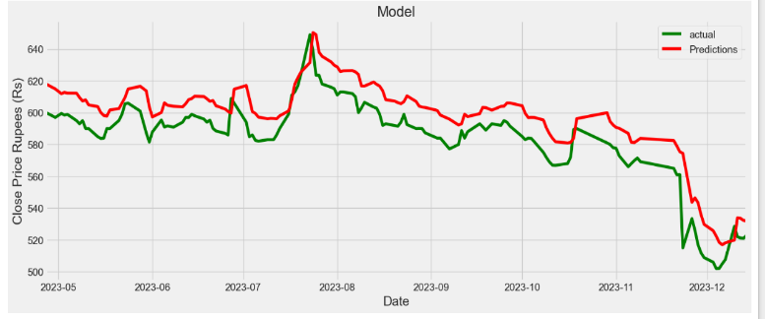
Results and Discussion
LSTM
On single parameters
OKRP Conference 2023

Slide 10
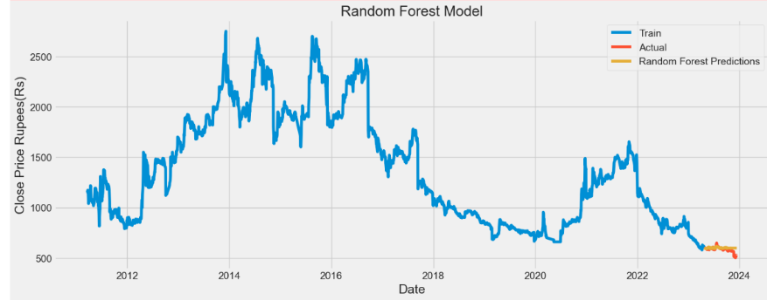
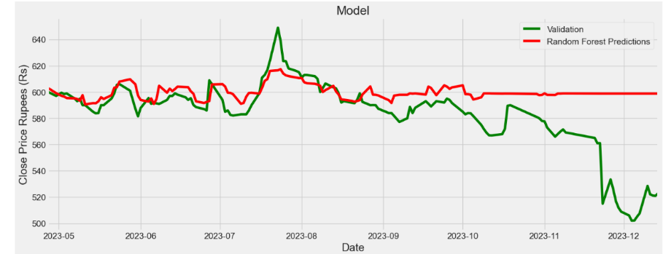
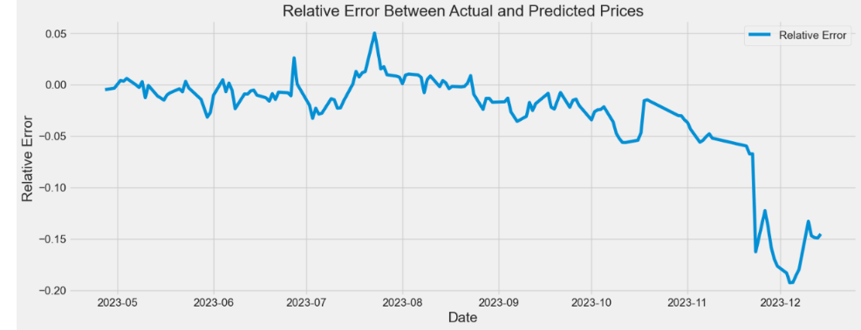

Single parameter: Random Forest
OKRP Conference 2023

Slide 11
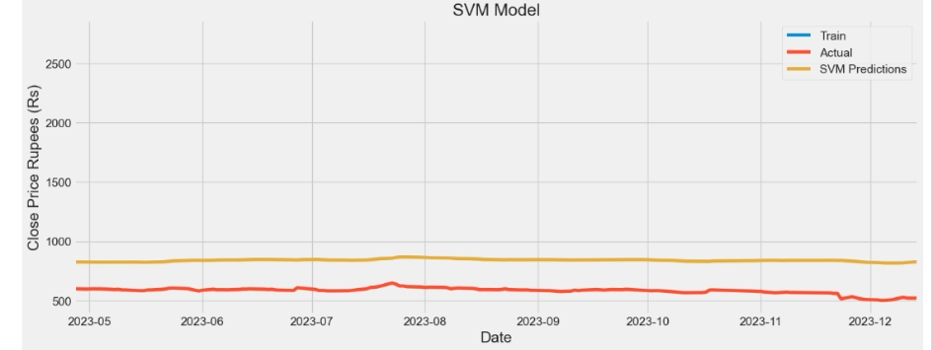
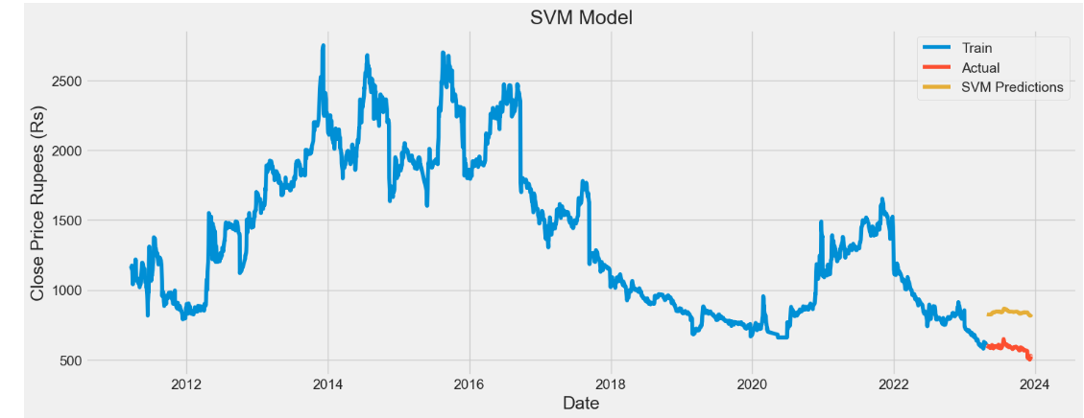
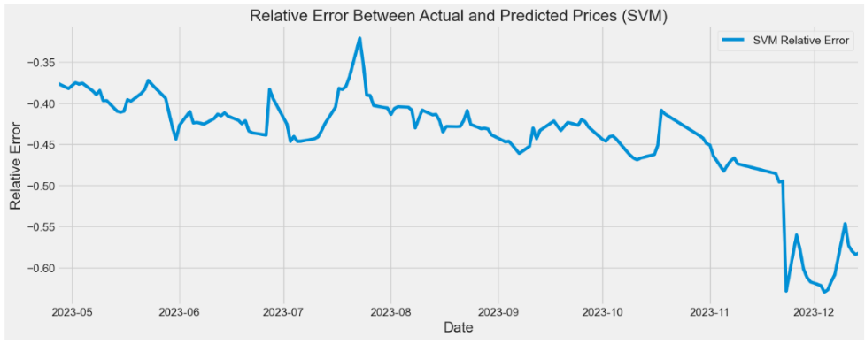

Single parameter: svm
OKRP Conference 2023

Slide 12
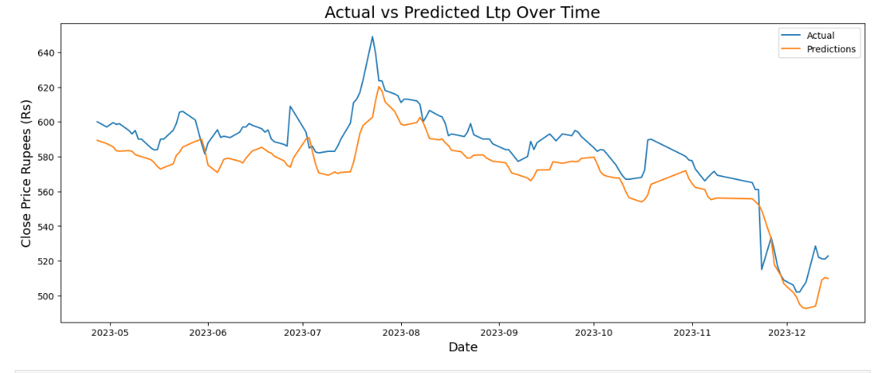
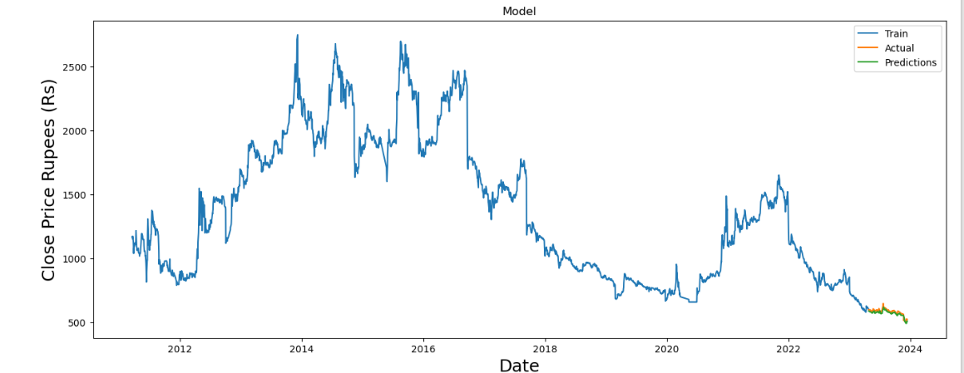
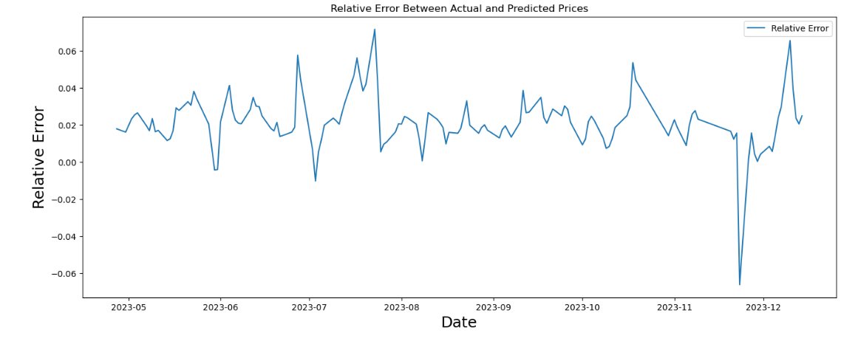

Multiple parameters and improvement: LSTM
OKRP Conference 2023

Slide 13
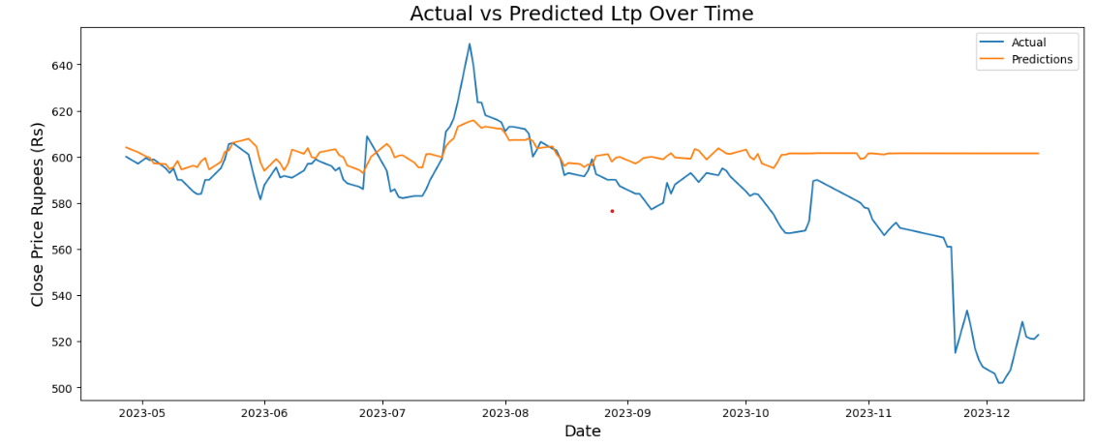
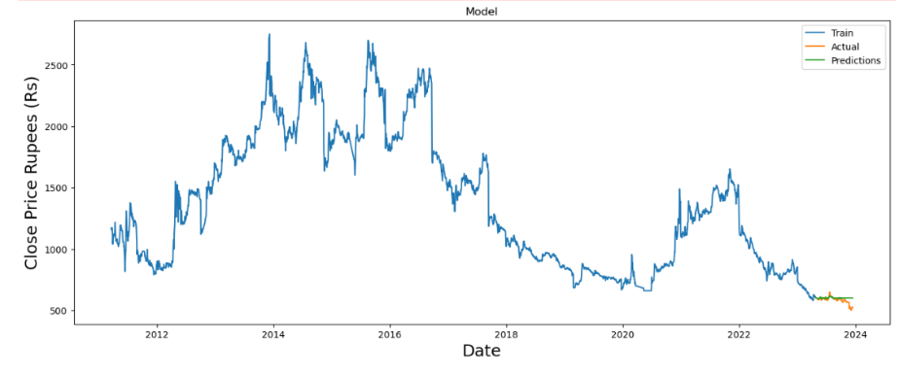
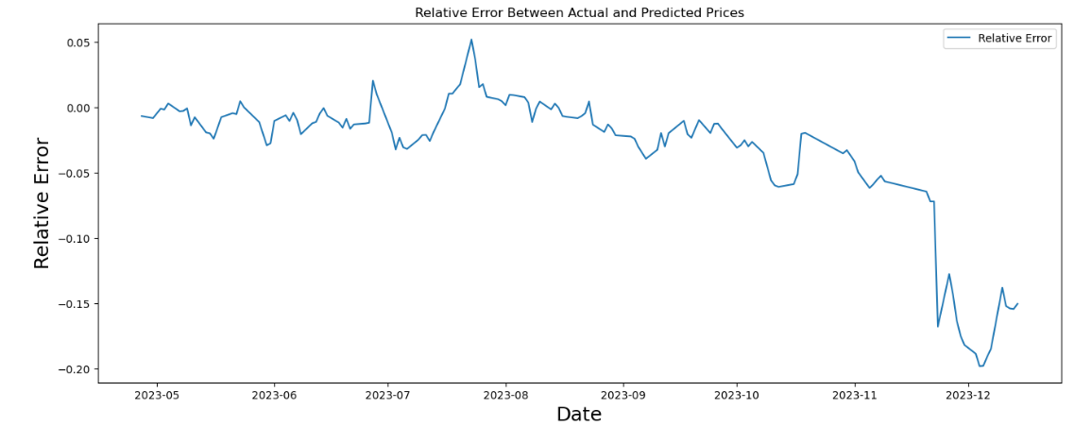

Multiple parameters and improvement: Random Forest
OKRP Conference 2023

Slide 14
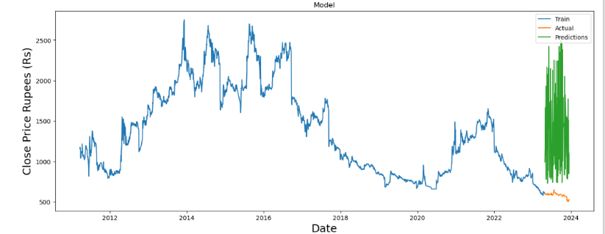
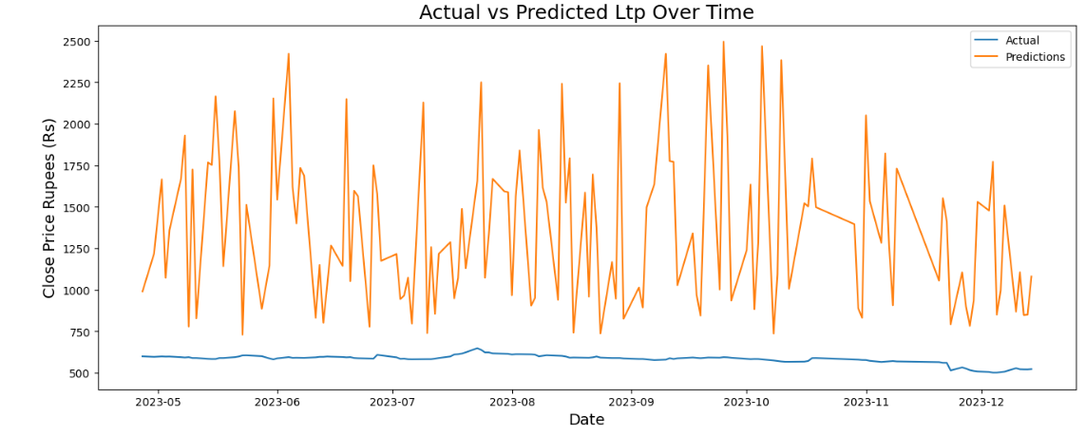

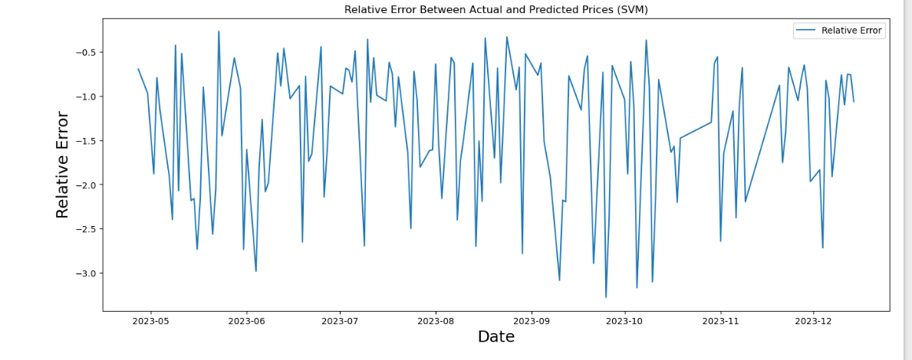
Multiple parameters and improvement: SVM
OKRP Conference 2023

Slide 15

Summary LSTM, Random forest, SVM
LSTM
Random forest
SVM
OKRP Conference 2023

Slide 16
Further enhancement
Further analysis on commercial bank like NIC Asia bank limited, NMB Bank limited and other stock index.
To use further technical parameter for the model to predict as seen in the result the increase on the parameter increase the prediction accuracy.
OKRP Conference 2023

Slide 17
Date | References |  | Paper name
2014 | Jigar Patel, Sahil Shah, Priyank Thakkar ⇑ , K. Kotecha | Patel et al. | Predicting stock and stock price index movement using Trend 4 Deterministic Data Preparation and machine learning techniques
2015 | Michel Ballings , Dirk Van den Poel , Nathalie Hespeels , Ruben Gryp | Bailings et al. | Evaluating multiple classifiers for stock price direction prediction
2013 | Yuling LIN, Haixiang GUO and Jinglu HU | Lin et al. | An SVM-based Approach for Stock Market Trend Prediction
2018 | Rui Ren, Member, IEEE, Desheng Dash Wu, Senior Member, IEEE, and Tianxiang Liu | Ren et al. | Forecasting Stock Market Movement Direction Using Sentiment Analysis and Support Vector Machine
2017 | Sreelekshmy Selvin, Vinayakumar R, Gopalakrishnan E.A, Vijay Krishna Menon, Soman K.P | Selvin et al. | STOCK PRICE PREDICTION USING LSTM,RNN AND CNN-SLIDING WINDOW MODEL
2015 | Kai Chen, Yi Zhou, Fangyan Dai | Chen et al. | A LSTM-based method for stock returns prediction : A case study of China stock market
2020 | Adil MOGHARa * ,Mhamed HAMICHEb | Moghara et al. | Stock Market Prediction Using LSTM Recurrent Neural Network
OKRP Conference 2023

Slide 18
Thank you
Question ?
OKRP Conference 2023

